Slide 1


Computer Networks
Week13_Lecture1 (Chapter3)
Transport Layer
Subhan Ullah, PhD
subhan.ullah@nu.edu.pk
BS(Computer Science) Spring-2024

Slide 2

Chapter 3: roadmap
Transport-layer services
Multiplexing and demultiplexing
Connectionless transport: UDP
Principles of reliable data transfer
Connection-oriented transport: TCP
segment structure
reliable data transfer
flow control
connection management
Principles of congestion control
TCP congestion control

Slide 3
Modified TCP – Doubling Timeout Interval
Whenever the timeout event occurs it sets the next timeout interval to twice the previous value,
rather than deriving it from the last EstimatedRTT and DevRTT
However, in case of other two events (app data received or ACK received), it is derived
It also provides a limited form of congestion control
Timer expiration due to congestion
It is better to wait rather than keep sending
Notes:
For example, suppose TimeoutInterval associated with the oldest not yet acknowledged segment is .75 sec when the timer first expires. TCP will then retransmit this segment and set the new expiration time to 1.5 sec. If the timer expires again 1.5 sec later, TCP will again retransmit this segment, now setting the expiration time to 3.0 sec.

Slide 4
Modified TCP – Fast Retransmit
Timeout-triggered retransmissions can take long
Duplicate ACKs can help sender to detect packet loss
A duplicate ACK is an ACK that reacknowledges a segment for which the sender has already received an earlier acknowledgment.
When it is sent/received?

Slide 5


TCP fast retransmit
Host A
Host B
TCP fast retransmit
if sender receives 3 additional ACKs for same data (“triple duplicate ACKs”), resend unACKed segment with smallest seq #
likely that unACKed segment lost, so don’t wait for timeout
Seq=92, 8 bytes of data
Seq=100, 20 bytes of data
X
ACK=100
timeout
ACK=100
ACK=100
Receipt of three duplicate ACKs indicates 3 segments received after a missing segment – lost segment is likely. So retransmit!
ACK=100
Seq=100, 20 bytes of data
Notes:
Let’s wrap up our study of TCP reliability by discussing an optimization to the original TCP known as TCP fast retransmit,
Take a look at this example on the right where 5 segments are transmitted and the second segment is lost. In this case the TCP receiver sends an ACK 100 acknowledging the first received segment.
When the third segment arrives at the receiver, the TCP receiver sends another ACK 100 since the second segment has not arrived. And similarly for the 4th and 5th segments to arrive.
Now what does the sender see? The sender receives the first ACK 100 it has been hoping for, but then three additional duplicate ACK100s arrive. The sender knows that somethings’ wrong – it knows the first segment arrived at the receiver but three later arriving segments at the receiver – the ones that generated the three duplicate ACKs – we received correctly but were not in order. That is, that there was a missing segment at the receiver when each of the three duplicate ACK were generated.
With fast retransmit, the arrival of three duplicate ACK causes the sender to retransmit its oldest unACKed segment, without waiting for a timeout event. This allows TCP to recover more quickly from what is very likely a loss event
specifically that the second segment has been lost, since three higher -numbered segments were received….
Note ! The reason that the sending side has to wait until the third duplicate ACK is described in RFC2001 as follows:
" Since TCP does not know whether a duplicate ACK is caused by a lost segment or just a reordering of segments, it waits for a small number of duplicate ACKs to be received. It is assumed that if there is just a reordering of the segments, there will be only one or two duplicate ACKs before the reordered segment is processed, which will then generate a new ACK. If three or more duplicate ACKs are received in a row, it is a strong indication that a segment has been lost. “
https://www.isi.edu/nsnam/DIRECTED_RESEARCH/DR_WANIDA/DR/JavisInActionFastRetransmitFrame.html

Slide 6
TCP uses Go-Back-N or Selective Repeat?
Go-Back-N?
TCP acknowledgments are cumulative
TCP sender need only maintain SendBase and NextSeqNum
So, What do you say?
Selective Repeat?
If n lost, only retransmit n
Receiver would buffer out of order segments
So? What do you say?
It can be considered as an hybrid of both Go-Back-N and Selective Repeat
Notes:
there are some striking differences between TCP and Go-Back-N. Many TCP implementations will buffer correctly received but out-of-order segments [Stevens 1994].
would retransmit at most one segment, namely, segment n.
Moreover, TCP would not even retransmit segment n if the acknowledgment for segment n + 1 arrived before the timeout for segment n.

Slide 7
Chapter 3: roadmap
Transport-layer services
Multiplexing and demultiplexing
Connectionless transport: UDP
Principles of reliable data transfer
Connection-oriented transport: TCP
segment structure
reliable data transfer
flow control
connection management
Principles of congestion control
TCP congestion control

Slide 8
TCP flow control
application
process
Q: What happens if network layer delivers data faster than application layer removes data from socket buffers?
Application removing data from TCP socket buffers
TCP socket
receiver buffers
TCP
code
Network layer delivering IP datagram payload into TCP socket buffers
IP
code
from sender
receiver protocol stack
Notes:
(Presuming an intro)
Before diving into the details of TCP flow control, let’s first get the general context and motivate the need for flow control.
This diagram show a typical transport-layer implementation
A segment is brought up the protocol stack to the transport layer, and the segment’s payload is removed from the segment and written INTO socket buffers.
How does data get taken OUT of socket buffers? By applications performing socket reads, as we learned in Chapter 2.
And so the question is “What happens if network layer delivers data faster than an application-layer process removes data from socket buffers?”
Let’s watch a video of what happens when things arrive way too fast to fast to be processed.
<video>. (I love that video). Another human analogy showing the need for flow control is the saying – to use some English slang - “no one can drink from a firehose”
Flow control is a mechanism to the calamity of a receiver being over-run by a sender that is sending too fast – it allows the RECEIVER to explicitly control the SENDER so sender won’t overflow receiver’s buffer by transmitting too much, too fast

Slide 9

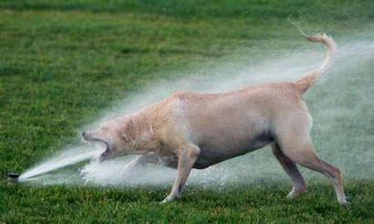
TCP flow control
application
process
Q: What happens if network layer delivers data faster than application layer removes data from socket buffers?
Application removing data from TCP socket buffers
TCP socket
receiver buffers
TCP
code
Network layer delivering IP datagram payload into TCP socket buffers
IP
code
from sender
receiver protocol stack
Notes:
(Presuming an intro)
Before diving into the details of TCP flow control, let’s first get the general context and motivate the need for flow control.
This diagram show a typical transport-layer implementation
A segment is brought up the protocol stack to the transport layer, and the segment’s payload is removed from the segment and written INTO socket buffers.
How does data get taken OUT of socket buffers? By applications performing socket reads, as we learned in Chapter 2.
And so the question is “What happens if network layer delivers data faster than an application-layer process removes data from socket buffers?”
Let’s watch a video of what happens when things arrive way too fast to fast to be processed.
<video>. (I love that video). Another human analogy showing the need for flow control is the saying – to use some English slang - “no one can drink from a firehose”
Flow control is a mechanism to the calamity of a receiver being over-run by a sender that is sending too fast – it allows the RECEIVER to explictly control the SENDER so sender won’t overflow receiver’s buffer by transmitting too much, too fast

Slide 10
TCP flow control
application
process
Q: What happens if network layer delivers data faster than application layer removes data from socket buffers?
Application removing data from TCP socket buffers
TCP socket
receiver buffers
TCP
code
receive window
flow control: # bytes receiver willing to accept
IP
code
from sender
receiver protocol stack
Notes:
(Presuming an intro)
Before diving into the details of TCP flow control, let’s first get the general context and motivate the need for flow control.
This diagram show a typical transport-layer implementation
A segment is brought up the protocol stack to the transport layer, and the segment’s payload is removed from the segment and written INTO socket buffers.
How does data get taken OUT of socket buffers? By applications performing socket reads, as we learned in Chapter 2.
And so the question is “What happens if network layer delivers data faster than an application-layer process removes data from socket buffers?”
Let’s watch a video of what happens when things arrive way too fast to fast to be processed.
<video>. (I love that video). Another human analogy showing the need for flow control is the saying – to use some English slang - “no one can drink from a firehose”
Flow control is a mechanism to the calamity of a receiver being over-run by a sender that is sending too fast – it allows the RECEIVER to explictly control the SENDER so sender won’t overflow receiver’s buffer by transmitting too much, too fast

Slide 11
TCP flow control
application
process
Q: What happens if network layer delivers data faster than application layer removes data from socket buffers?
Application removing data from TCP socket buffers
TCP socket
receiver buffers
TCP
code
flow control
receiver controls sender, so sender won’t overflow receiver’s buffer by transmitting too much, too fast
IP
code
from sender
receiver protocol stack
Notes:
(Presuming an intro)
Before diving into the details of TCP flow control, let’s first get the general context and motivate the need for flow control.
This diagram show a typical transport-layer implementation
A segment is brought up the protocol stack to the transport layer, and the segment’s payload is removed from the segment and written INTO socket buffers.
How does data get taken OUT of socket buffers? By applications performing socket reads, as we learned in Chapter 2.
And so the question is “What happens if network layer delivers data faster than an application-layer process removes data from socket buffers?”
Let’s watch a video of what happens when things arrive way too fast to fast to be processed.
<video>. (I love that video). Another human analogy showing the need for flow control is the saying – to use some English slang - “no one can drink from a firehose”
Flow control is a mechanism to the calamity of a receiver being over-run by a sender that is sending too fast – it allows the RECEIVER to explicitly control the SENDER so sender won’t overflow receiver’s buffer by transmitting too much, too fast

Slide 12
TCP flow control
TCP receiver “advertises” free buffer space in rwnd field in TCP header
RcvBuffer size set via socket options (typical default is 4096 bytes)
many operating systems autoadjust RcvBuffer
sender limits amount of unACKed (“in-flight”) data to received rwnd
guarantees receive buffer will not overflow
to application process
RcvBuffer
buffered data
rwnd
free buffer space
TCP segment payloads
TCP receiver-side buffering
Notes:
Here’s how TCP implement flow control. The basic idea is simple – the receiver informs the sender how much free buffer space there is, and the sender is limited to send no more than this amount of data. That the value o RWND in the diagram to the right.
This information is carried from the receiver to the sender in the “receiver advertised window” (do a PIP of header) in the TCP header, and the value will change as the amount of free buffer space fluctuates over time.

Slide 13
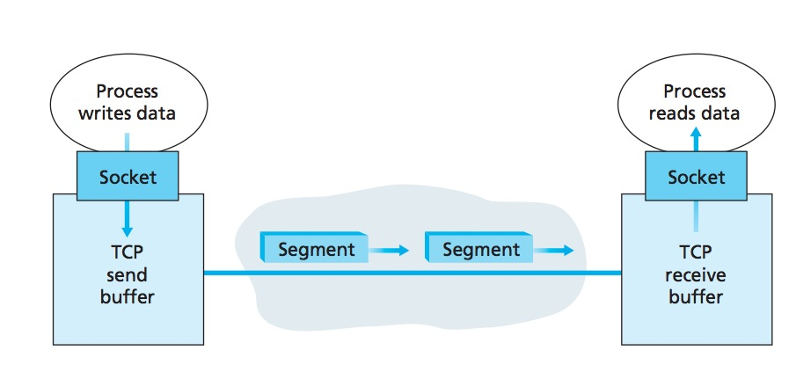
TCP Send/Receive buffers (revisit)
If the application is relatively slow at reading the data, the sender can very easily overflow the connection’s receive buffer by sending too much data too quickly.
The received bytes over a TCP connection are placed in the receive buffer.
App process will read data from this buffer,
not necessarily at the instant the data arrives.
It may be busy with some other task
If app processes relatively slow at reading data,
the sender can very easily overflow the buffer

Slide 14
TCP Flow-Control
TCP provides flow-control to eliminate the possibility of the sender overflowing the receiver’s buffer
It is a speed-matching service
matching the rate at which the sender is sending against the rate at which the receiving application is reading
TCP sender maintains a variable called the receive window.
TCP is full-duplex, sender at each side of connection maintains distinct receive window
It gives sender an idea of how much free buffer space is available at the receiver

Slide 15
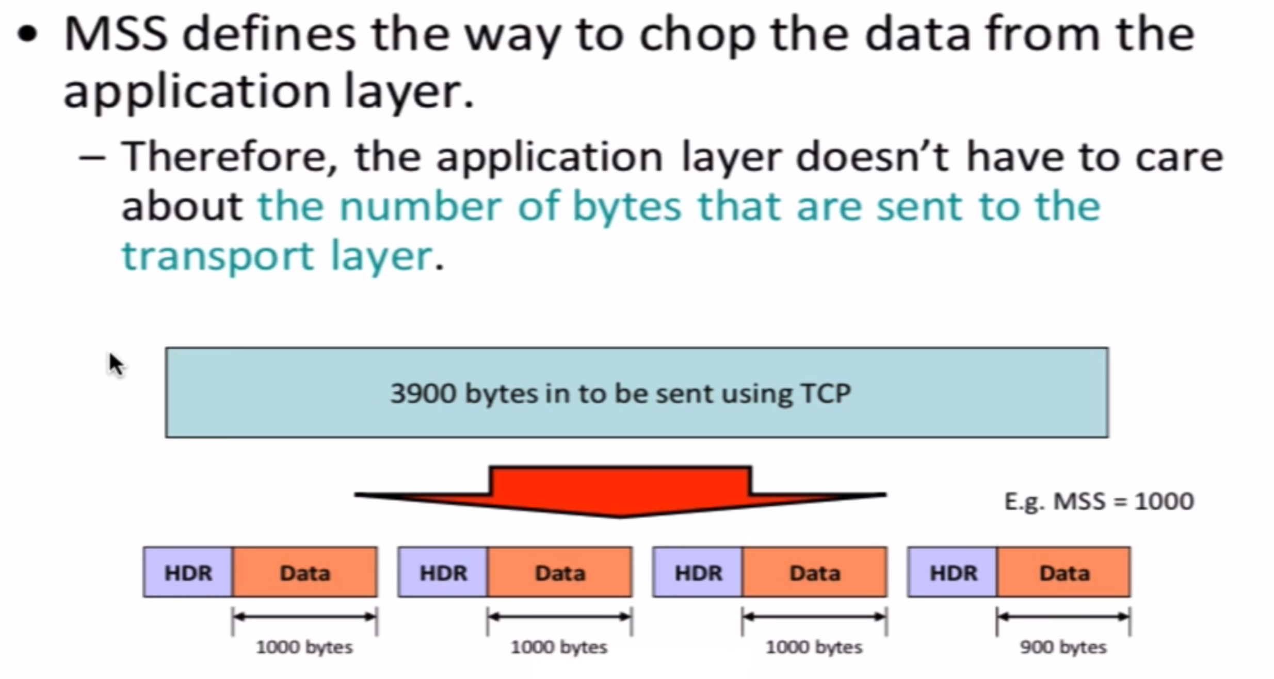
TCP Flow-Control

Slide 16
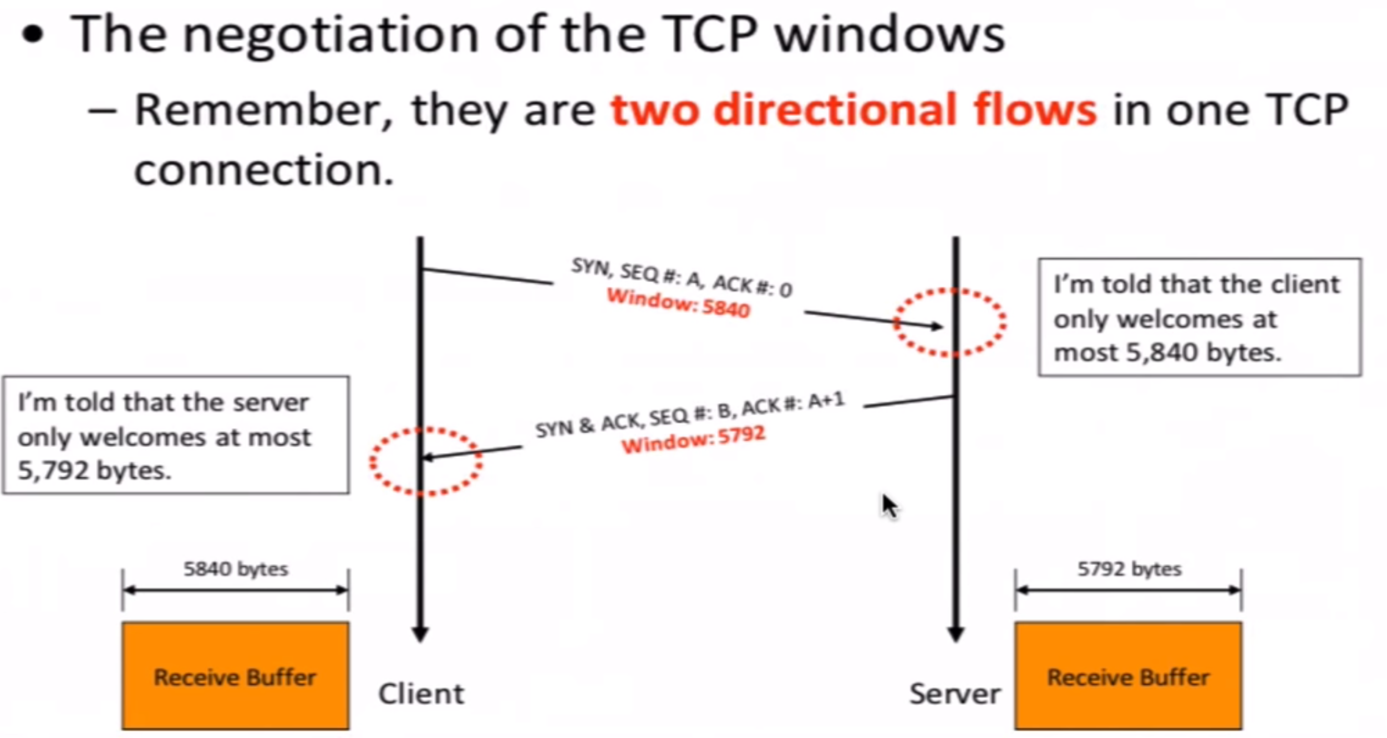
TCP Flow-Control
Notes:
Also covered from TCP until here…..: for section G: 24/11/2021

Slide 17
TCP Flow-Control
How to calculate the window size?
Suppose that Host A is sending a large file to Host B over a TCP connection.
Host B allocates a receive buffer to this connection; denote its size by RcvBuffer
The app reads from this buffer

Slide 18
TCP Flow-Control – Receiver Side
We define following variables
LastByteRead: the number of the last byte in the data stream read from the buffer by the application process in B
LastByteRcvd: the number of the last byte in the data stream that has arrived from the network and has been placed in the receive buffer at B
The receive window, denoted rwnd is set to the amount of spare room in the buffer:
rwnd = RcvBuffer – [LastByteRcvd – LastByteRead]
Because the spare room changes with time, rwnd is dynamic

Slide 19
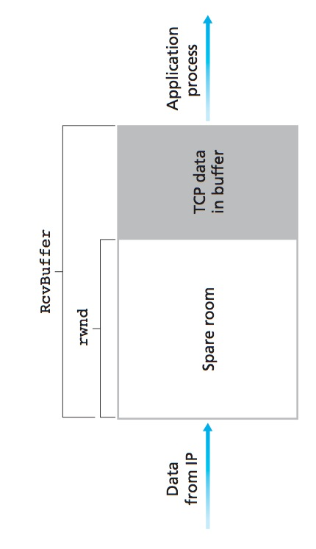
TCP Flow-Control – Receiver Side
rwnd = RcvBuffer – [LastByteRcvd – LastByteRead]

Slide 20
TCP Flow-Control – Receiver Side
How does the connection use the variable rwnd to provide the flow-control service?
Host B tells Host A how much spare room it has in the connection buffer by placing its current value of rwnd in the receive window field of every segment it sends to A.
Initially, Host B sets rwnd = RcvBuffer.
How many rwnd variables should the Host B keep?
One for each connection

Slide 21
TCP Flow-Control – Sender Side
What variables Host A should keep?
LastByteSent and LastByteAcked
LastByteSent – LastByteAcked, is the amount of unacknowledged data that A has sent into the connection
For flow control, Host A keeps the amount of unacknowledged data less than the value of rwnd
LastByteSent – LastByteAcked <= rwnd

Slide 22
One special case …
Host B’s receive buffer becomes full so that rwnd = 0
After advertising rwnd = 0 to Host A, also suppose that B has nothing to send to A
When buffer empties, how would A know?
Solution:
Host A continues to send segments with one data byte when B’s receive window is zero
These segments will be acknowledged by the receiver. Eventually the buffer will begin to empty and the acknowledgments will contain a nonzero rwnd value

Slide 23
TCP flow control
flow control: # bytes receiver willing to accept
TCP receiver “advertises” free buffer space in rwnd field in TCP header
RcvBuffer size set via socket options (typical default is 4096 bytes)
many operating systems autoadjust RcvBuffer
sender limits amount of unACKed (“in-flight”) data to received rwnd
guarantees receive buffer will not overflow
receive window
TCP segment format
Notes:
Here’s how TCP implement flow control. The basic idea is simple – the receiver informs the sender how much free buffer space there is, and the sender is limited to send no more than this amount of data. That the value o RWND in the diagram to the right.
This information is carried from the receiver to the sender in the “receiver advertised window” (do a PIP of header) in the TCP header, and the value will change as the amount of free buffer space fluctuates over time.

Slide 24
TCP connection management
before exchanging data, sender/receiver “handshake”:
agree to establish connection (each knowing the other willing to establish connection)
agree on connection parameters (e.g., starting seq #s)
application
application
connection state: ESTAB
connection variables:
seq # client-to-server
server-to-client
rcvBuffer size
at server,client
connection state: ESTAB
connection Variables:
seq # client-to-server
server-to-client
rcvBuffer size
at server,client
network
network
Socket clientSocket =
newSocket("hostname","port number");
Socket connectionSocket = welcomeSocket.accept();
Notes:
The other TCP topic we’ll want to consider here is that of “connection management”
The TCP sender and reciver have a number of pieces of shared state that they must establish before actually communication
FIRST theym ust both agree that they WANT to communicate with each other
Secondly there are connection parameters – the initial sequence number and the initial receiver-advertised bufferspace that they’ll want to agree on
This is done via a so-called handshake protocol – the client reaching our to the server, and the server answering back.
And before diving into the TCP handshake protocol, let’s first consider the problem of handshaking, of establishing shared state.

Slide 25


Agreeing to establish a connection
2-way handshake:
Q: will 2-way handshake always work in network?
variable delays
retransmitted messages (e.g. req_conn(x)) due to message loss
message reordering
can’t “see” other side
Let’s talk
ESTAB
OK
ESTAB
choose x
req_conn(x)
ESTAB
acc_conn(x)
ESTAB
Notes:
Here’s an example of a two way handshake. Alice reaches out to Bob and say’s “let’s talk” and Bob says OK, and they start their conversation
For a network protocol, the equivalent protocol would be a client sending a “request connection” message saying ”let’s talk, the initial sequence number is x”
And the server would respond with a message ”I accept your connect x”
And the question we want to ask ourselves is <talk through>
Will this work? Let’s look at a few scenarios…

Slide 26

2-way handshake scenarios
choose x
req_conn(x)
ESTAB
acc_conn(x)
ESTAB
data(x+1)
accept
data(x+1)
ACK(x+1)
connection
x completes
No problem!

Slide 27

2-way handshake scenarios
choose x
req_conn(x)
ESTAB
retransmit
req_conn(x)
acc_conn(x)
ESTAB
req_conn(x)
connection
x completes
client terminates
server
forgets x
ESTAB
acc_conn(x)
Problem: half open connection! (no client)

Slide 28
2-way handshake scenarios
choose x
req_conn(x)
ESTAB
retransmit
req_conn(x)
acc_conn(x)
ESTAB
data(x+1)
accept
data(x+1)
retransmit
data(x+1)
connection
x completes
client terminates
server
forgets x
req_conn(x)
ESTAB
data(x+1)
accept
data(x+1)
Problem: dup data
accepted!

Slide 29
TCP 3-way handshake
Server state
Client state
serverSocket = socket(AF_INET,SOCK_STREAM)
serverSocket.bind((‘’,serverPort))
serverSocket.listen(1)
connectionSocket, addr = serverSocket.accept()
clientSocket = socket(AF_INET, SOCK_STREAM)
LISTEN
clientSocket.connect((serverName,serverPort))
LISTEN
choose init seq num, x
send TCP SYN msg
SYNSENT
SYNbit=1, Seq=x
choose init seq num, y
send TCP SYNACK
msg, acking SYN
SYN RCVD
SYNbit=1, Seq=y
ACKbit=1; ACKnum=x+1
received SYNACK(x)
indicates server is live;
send ACK for SYNACK;
this segment may contain
client-to-server data
ESTAB
ACKbit=1, ACKnum=y+1
received ACK(y)
indicates client is live
ESTAB
Notes:
TCP’s three way handshake, that operates as follows
Let’s say the client and server both create a TCP socket as we learned about in Chapter 2 and enter the LISTEN state
The client then connects to the server sending a SYN message with a sequence number x (SYN Message is an TCP Segment with SYN but set in the header – you might want to go back and review the TCP segment format!)
The server is waiting for a connection, and receives the SYN message enters the SYN received state (NOT the established state and sends a SYN ACK message back.
Finally the client sends an ACK message to the server, and when the server receiver this enters the ESTABLished state. This is when the application process would see the return from the wait on the socket accept() call

Slide 30
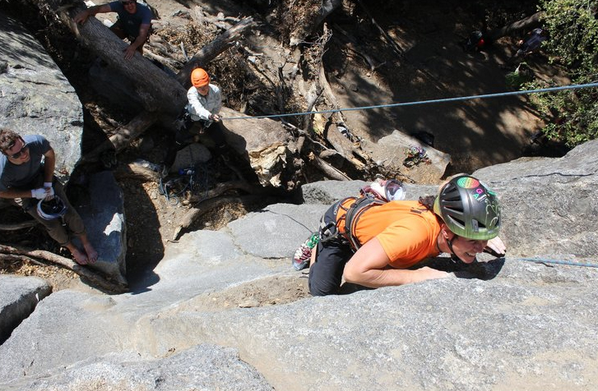
A human 3-way handshake protocol
1. On belay?
2. Belay on.
3. Climbing.
Notes:
As usual, there’s a human protocol analogy to the three way handshake, and I still remember thinking about this clinging for my life while climbing up a rockface
When you want start climbing you first say ON BELOW (meaning ARE YOU READY WITH MY SAFETY ROPE)
THE BELYER (server) responds BELAY ON (that lets you know the belayer is ready for you)
And then you say CLIMING
It’s amazing what can pass through your head when your clinging for your life o a

Slide 31
Closing a TCP connection
client, server each close their side of connection
send TCP segment with FIN bit = 1
respond to received FIN with ACK
on receiving FIN, ACK can be combined with own FIN
simultaneous FIN exchanges can be handled
Notes:
All good things must come to an end, and that’s true for a TCP connection as well.
And of course there’s a protocol for one side to gracefully close of a TCP connection using a FIN message, to which the other side sends a FINACK message and waits around a bit to respond to any retransmitted FIN messages before timing out.

Slide 32


Thank You All
☺
?
A note on the origin of these ppt slides:
All material copyright 1996-2020 J.F Kurose and K.W. Ross, All Rights Reserved
These slides are freely provided by the book authors and it represents a lot of work on their part. We would like to thank J.F Kurose and K.W. Ross.
Transport Layer: 3-150
Notes:
Section F and G ended

